Slide 1
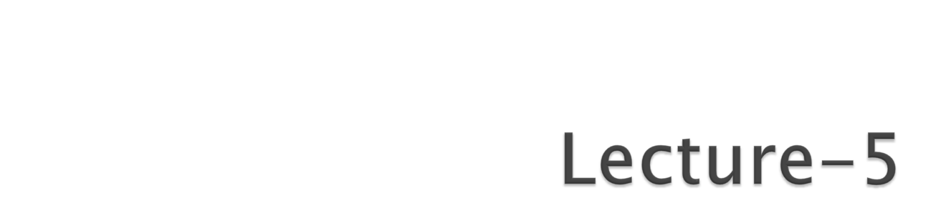
Functions

Slide 2

Definition & Explanation
Anatomy of Functions
Types of Functions
Passing Array to a Function
Recursion
Recursion vs. Iteration
Preprocessor Directives
Macros
Assignments

Slide 3
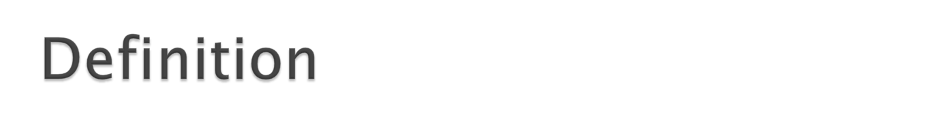
A function relates input to an output.
A function is a process or a relation that associates each element x of a set X, the domain of the function, to a single element y of another set Y (possibly the same set), the codomain of the function.

Slide 4
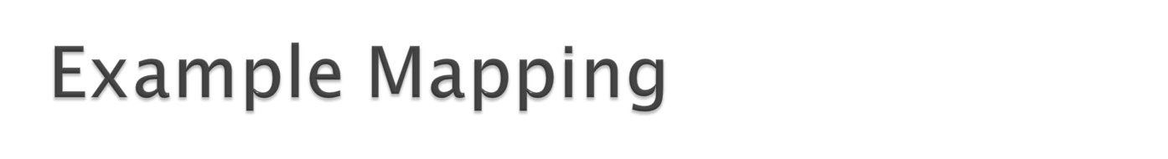
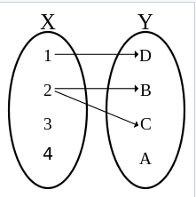
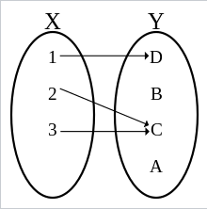
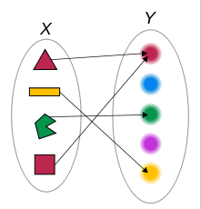

Slide 5

Function calls
  Invoking functions
    Provide function name and arguments (data)
    Function performs operations or manipulations
    Function returns results
  Function call analogy:
    Boss asks worker to complete task
      Worker gets information, does task, returns result
      Information hiding: boss does not know details

Slide 6
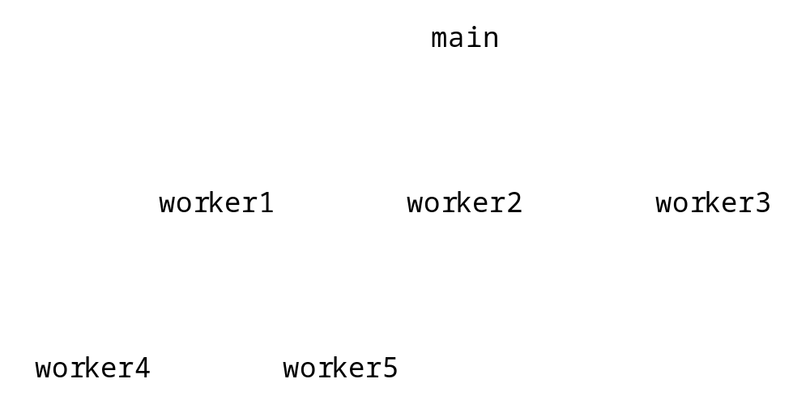
Hierarchical boss function/worker function relationship.

Slide 7

We decompose a program into functions for several reasons:
to hide irrelevant detail at the main() level, so the the program's primary purpose is clearer
to divide a complex problem into a series of simple problems
to make subsequent modification of the program easier
to reduce the errors that inevitably come with a single large complex program

Slide 8
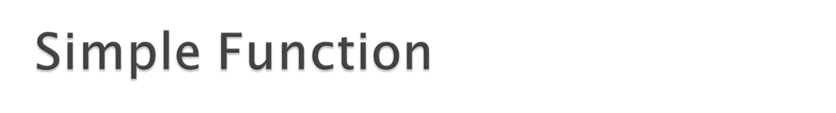
Example:
void beep(void);
void main(void)
{
printf(“Testing of UDF…..”);
beep();
beep();
}
void beep(void)
{
printf(“\a”);
}

Slide 9
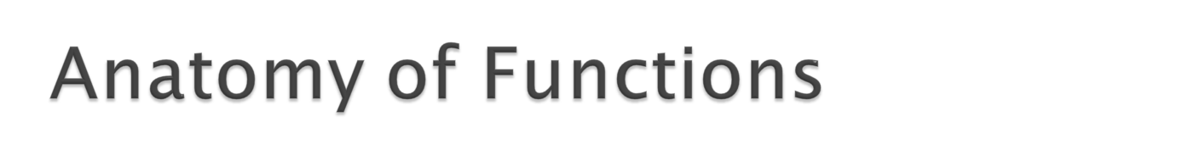
There are three program elements involved in previous example, which are:
Function Prototype: Declaration a function
Function Calls: Executes a function
Function Definition: The function itself

Slide 10
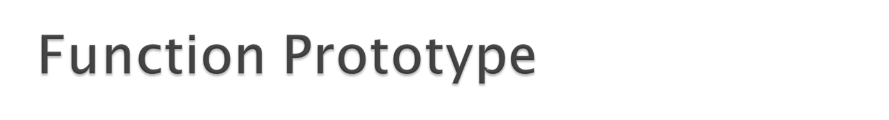
Function prototype
  Function name
  Parameters – what the function takes in
  Return type – data type function returns (default int)
  Prototype only needed if function definition comes after use in program
  The function with the prototype
    int maximum( int x, int y, int z );
    Takes in 3 ints
    Returns an int
Promotion rules and conversions
  Converting to lower types can lead to errors

Slide 11
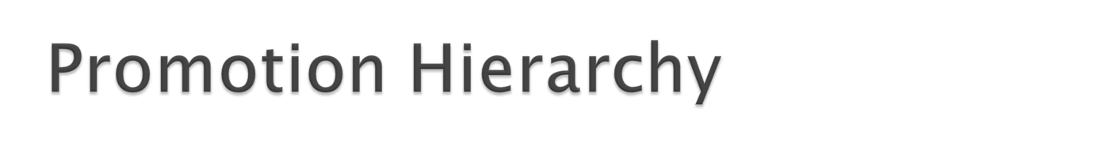
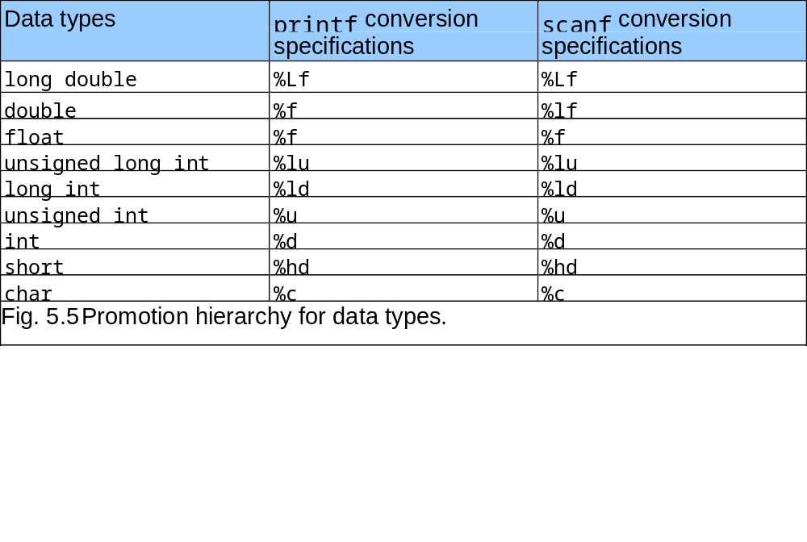

Slide 12
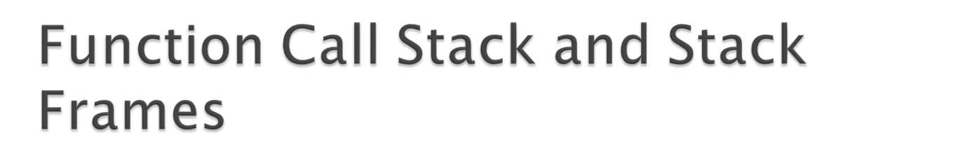
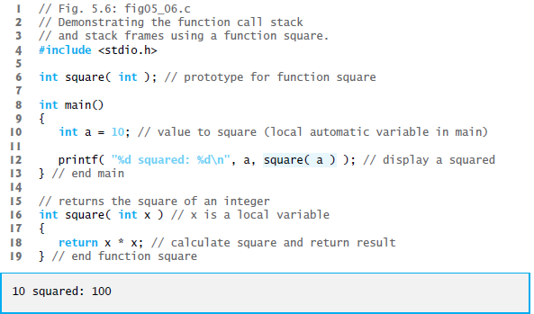

Slide 13
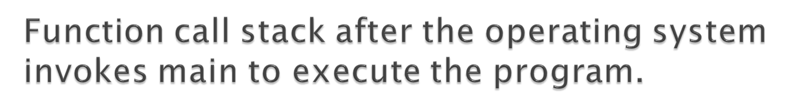
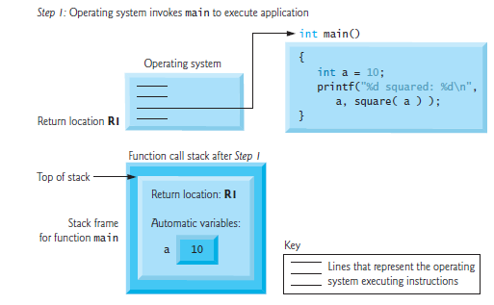

Slide 14
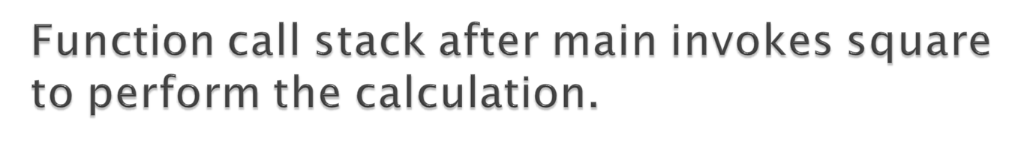
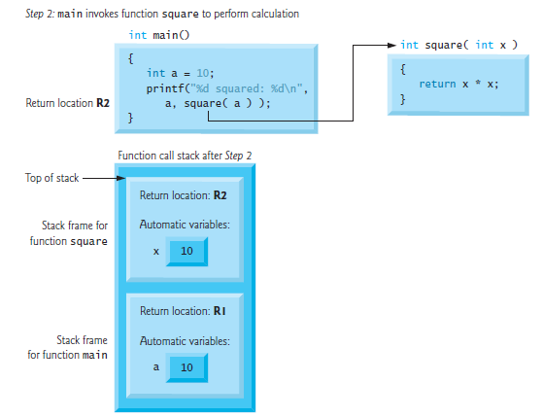

Slide 15
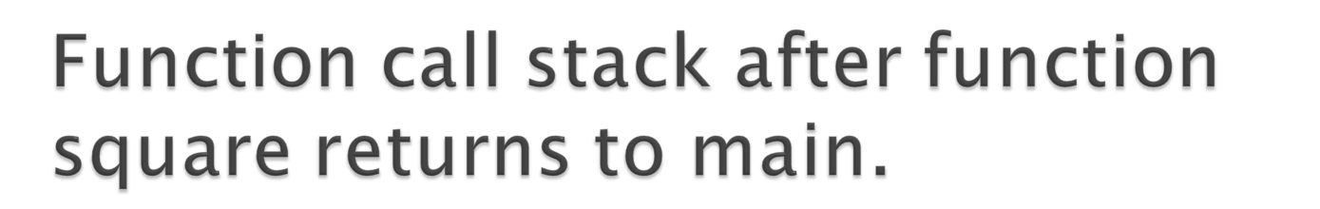
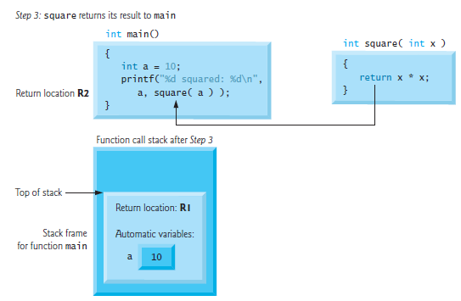

Slide 16
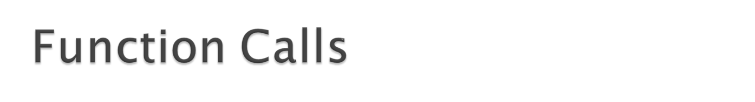
Call by value
  Copy of argument passed to function
  Changes in function do not effect original
  Use when function does not need to modify argument
    Avoids accidental changes
Call by reference
  Passes original argument
  Changes in function effect original
  Only used with trusted functions

Slide 17
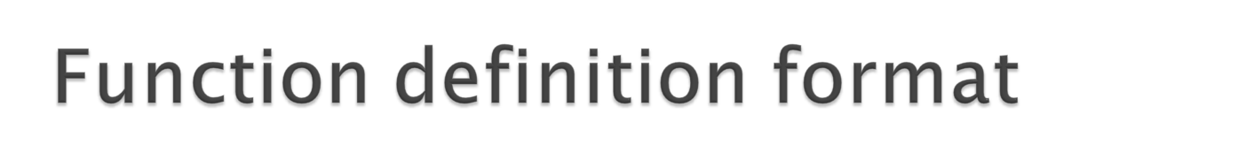
Syntax:
    return-value-type function-name( parameter-list )
    {
    declarations and statements
    }
  Function-name: any valid identifier
  Return-value-type: data type of the result (default int)
    void – indicates that the function returns nothing
  Parameter-list: comma separated list, declares parameters
    A type must be listed explicitly for each parameter unless, the parameter is of type int

Slide 18
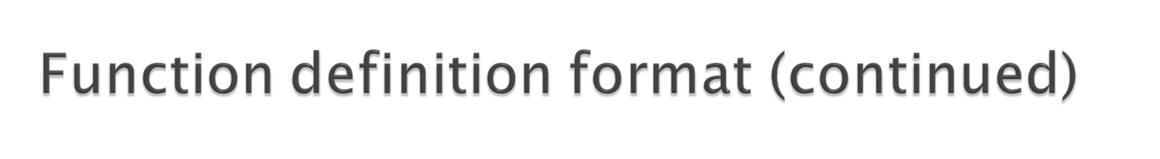
Function definition format (continued)
    return-value-type function-name( parameter-list )
    {
    declarations and statements
    }
  Definitions and statements: function body (block)
    Variables can be defined inside blocks (can be nested)
    Functions can not be defined inside other functions
  Returning control
    If nothing returned
      return;
      or, until reaches right brace
    If something returned
      return expression;

Slide 19
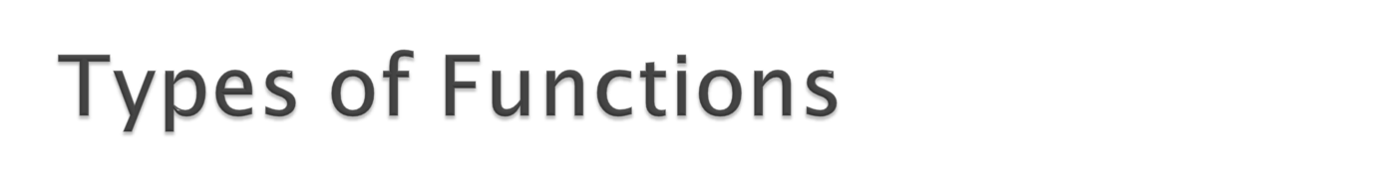
No return and no parameter(s)
No return but take parameter(s)
Return some thing but no parameter(s)
Return some thing as well as take parameter(s)

Slide 20

int sumsqr(int, int);
int sqr(int);
int sum(int, int);
void main(void)
{ int num1, num2;
printf(“Type two numbers: “);
scanf(“%d %d”,&num1,&num2);
printf(“Sum of the squares is %d”, sumsqr(num1,num2)); }
int sumsqr(int j, int k)
{ return( sum (sqr(j), sqr(k)); }
int sqr( int z)
{ return(z * z); }
int sum(int x , int y)
{ return( x+y); }

Slide 21
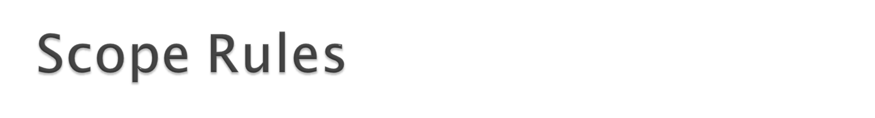
The scope of an identifier is the portion of the program in which the identifier can be referenced.
The four identifier scopes are:
  function scope,
  file scope,
  block scope, and
  function-prototype scope.
Local variables declared as static retain their values even when they’re out of scope.

Slide 22

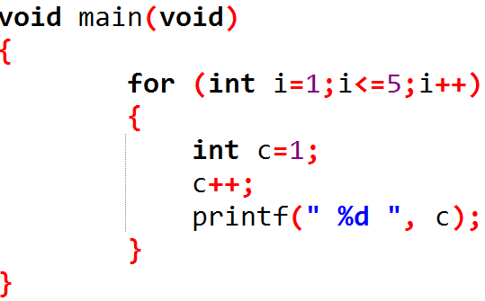
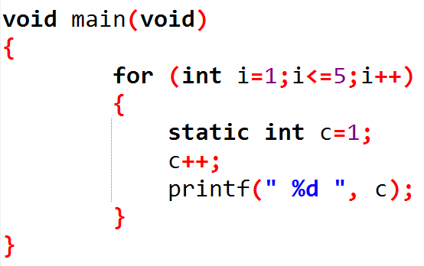

Slide 23

Recursive functions
  Functions that call themselves
  Can only solve a base case
  Divide a problem up into
    What it can do
    What it cannot do
      What it cannot do resembles original problem
      The function launches a new copy of itself (recursion step) to solve what it cannot do
  Eventually base case gets solved
    Gets plugged in, works its way up and solves whole problem

Slide 24
Example: factorials
  5! = 5 * 4 * 3 * 2 * 1
  Notice that
    5! = 5 * 4!
    4! = 4 * 3! ...
  Can compute factorials recursively
  Solve base case (1! = 0! = 1) then plug in
    2! = 2 * 1! = 2 * 1 = 2;
    3! = 3 * 2! = 3 * 2 = 6;

Slide 25
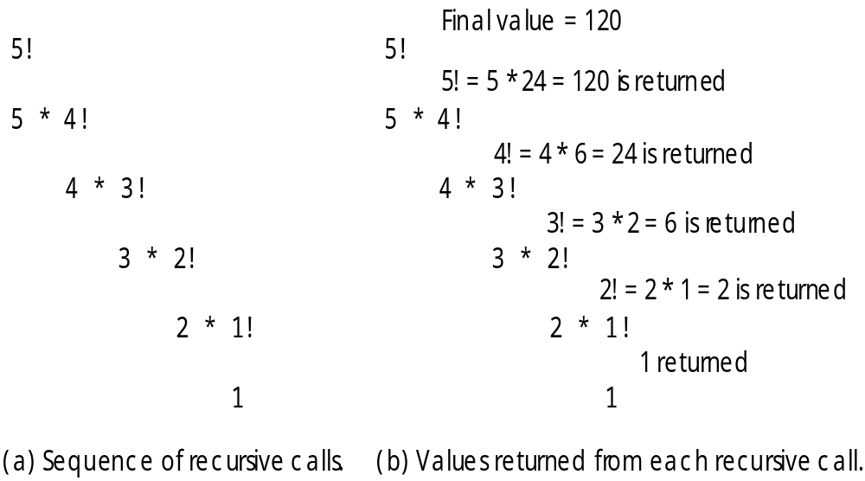

Slide 26
long factorial(long num);
void main(void)
{ int i; clrscr();
for(i=1; i<=10; i++)
printf(“%2d! = %ld \n “, I, factorial(i));
}
long factorial(long num)
{
if (num == 1)
return(1);
else
return( num * factorial(num-1) );
}

Slide 27
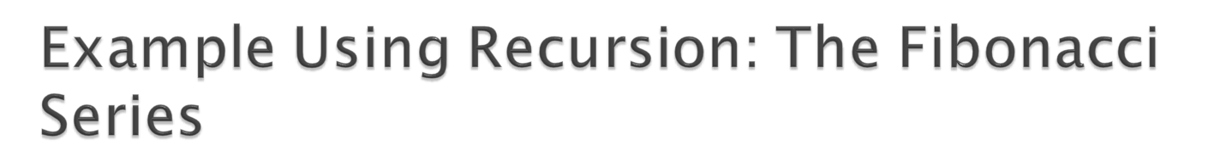
Fibonacci series: 0, 1, 1, 2, 3, 5, 8...
  Each number is the sum of the previous two
  Can be solved recursively:
    fib( n ) = fib( n - 1 ) + fib( n – 2 )
  Code for the fibonacci function
    long fibonacci( long n )
    {
    if (n == 0 || n == 1) // base case
    return n;
    else
    return fibonacci( n - 1) +
    fibonacci( n – 2 );
    }

Slide 28
Set of recursive calls to function Fibonacci
f( 3 )
return
f( 2 )
+
f( 1 )
return
f( 1 )
+
f( 0 )
return 1
return 1
return 0

Slide 29

Repetition
  Iteration: explicit loop
  Recursion: repeated function calls
Termination
  Iteration: loop condition fails
  Recursion: base case recognized
Both can have infinite loops
Balance
  Choice between performance (iteration) and good software engineering (recursion)

Slide 30
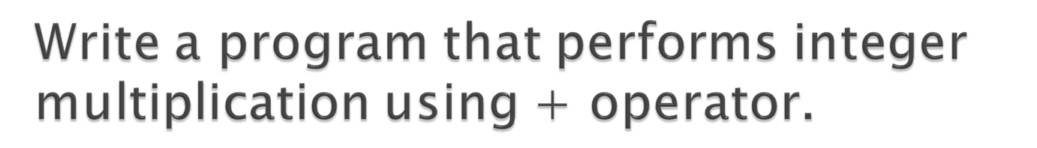
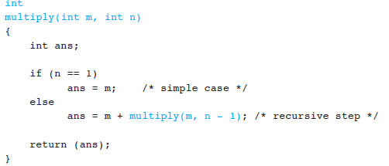

Slide 31

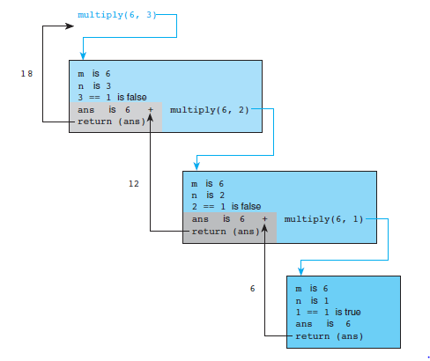

Slide 32

Display series from 1 to 10.
Display following pattern:
a
a b
a b c
a b c d
a b c d e
Get the character and display until he/she hits the enter key. Finally show the count of total typed characters.

Slide 33

The C preprocessor executes before a program is compiled.
Normal program statements are instructions to the microprocessor; preprocessor directives are instructions to the compiler.
The preprocessor more or less provides its own language which can be a very powerful tool to the programmer. Recall that all preprocessor directives or commands begin with a #.

Slide 34
Use of the preprocessor is advantageous since it makes:
  programs easier to develop,
  easier to read,
  easier to modify
  C code more transportable between different machine architectures.
Here we’ll examine two of the most common preprocessor directives, #define and #include.

Slide 35
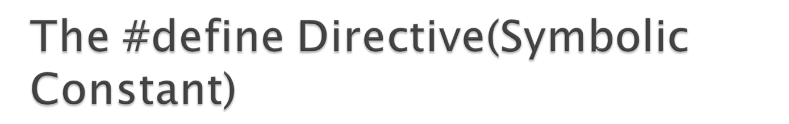
The simplest use for the define directive is to assign names to constants. e.g.
#define PI 3.14159 //macro definition
float area (float);
void main(void)
{
float radius;
printf(“Enter radius of sphere: “);
scanf(“%f”,&radius);
printf(“Area of sphere is %.2f”, area(radius) );
}
float area( float rad)
{ return(4 * PI * rad * rad ); }

Slide 36
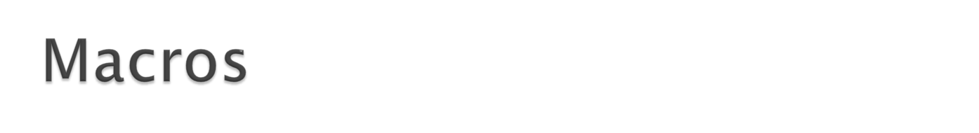
The macro that we have used so far is called simple macro. Macros can have arguments, just as functions can.
e.g.
#define Area(x) (3.14 * x * x)
main()
{
float r1=4.6; r2= 6.25;
a=Area(r1);
printf(“\nArea of Circle = %f “, a);
a=Area(r2);
printf(“\nArea of Circle = %f”, a);
}

Slide 37

#define sum(x, y) x + y
---------
ans = 10 * sum(3,4)
#define product(x, y) (x * y)
---------
ans = product(2 +3, 4)
What will be the result ?
  20
  14

Slide 38
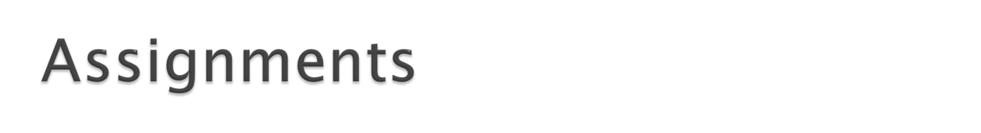
A positive integer is entered through the keyboard, write a function to find the binary equivalent of this number.
Write a program to find the area of triangle. If the lengths of the sides of a triangle are denoted by a, b, and c, then area of triangle is given by
--------------------
Write down macro definitions to obtain the bigger of two numbers.
Write a program that extract any string from the mid of the input string by using user define function of following type :
char = mid ( string , position, no. of chars)
Write a program which take a sequence no from a Fibonacci series and then return the value lie on that sequence no.

Slide 39
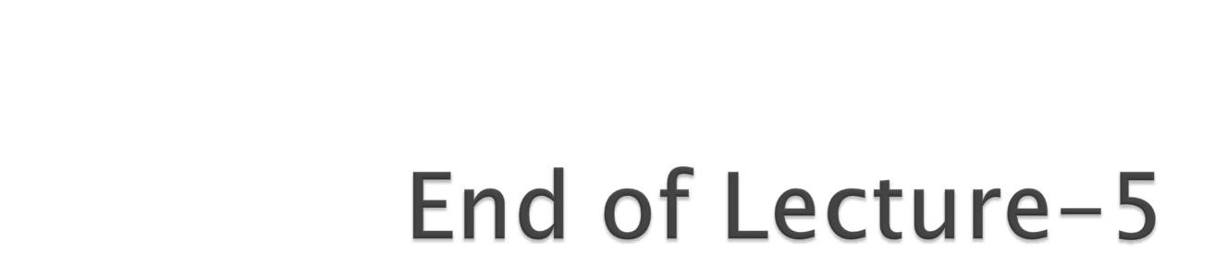
Any Questions ?????

